Slide 2
describe|
|harmonize
smoking
D
H
ALSA
dto
age
dto
D
H
LBLS
sex
D
H
Ellis
Island
education
SATSA
harmony
dto
D
H
marital
SHARE
D
H
…
TILDA
construct
D
H

Slide 3
dto
graph
smoke_now
harmony
dto
model

Slide 4
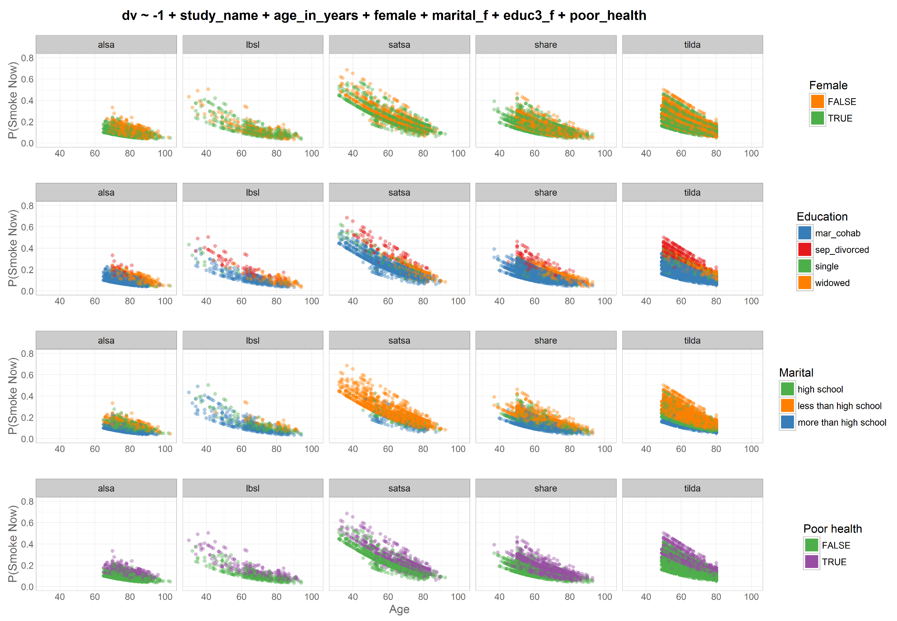
Odds|
|Prob
Study =
factor
dto
harmony
dto

Slide 5
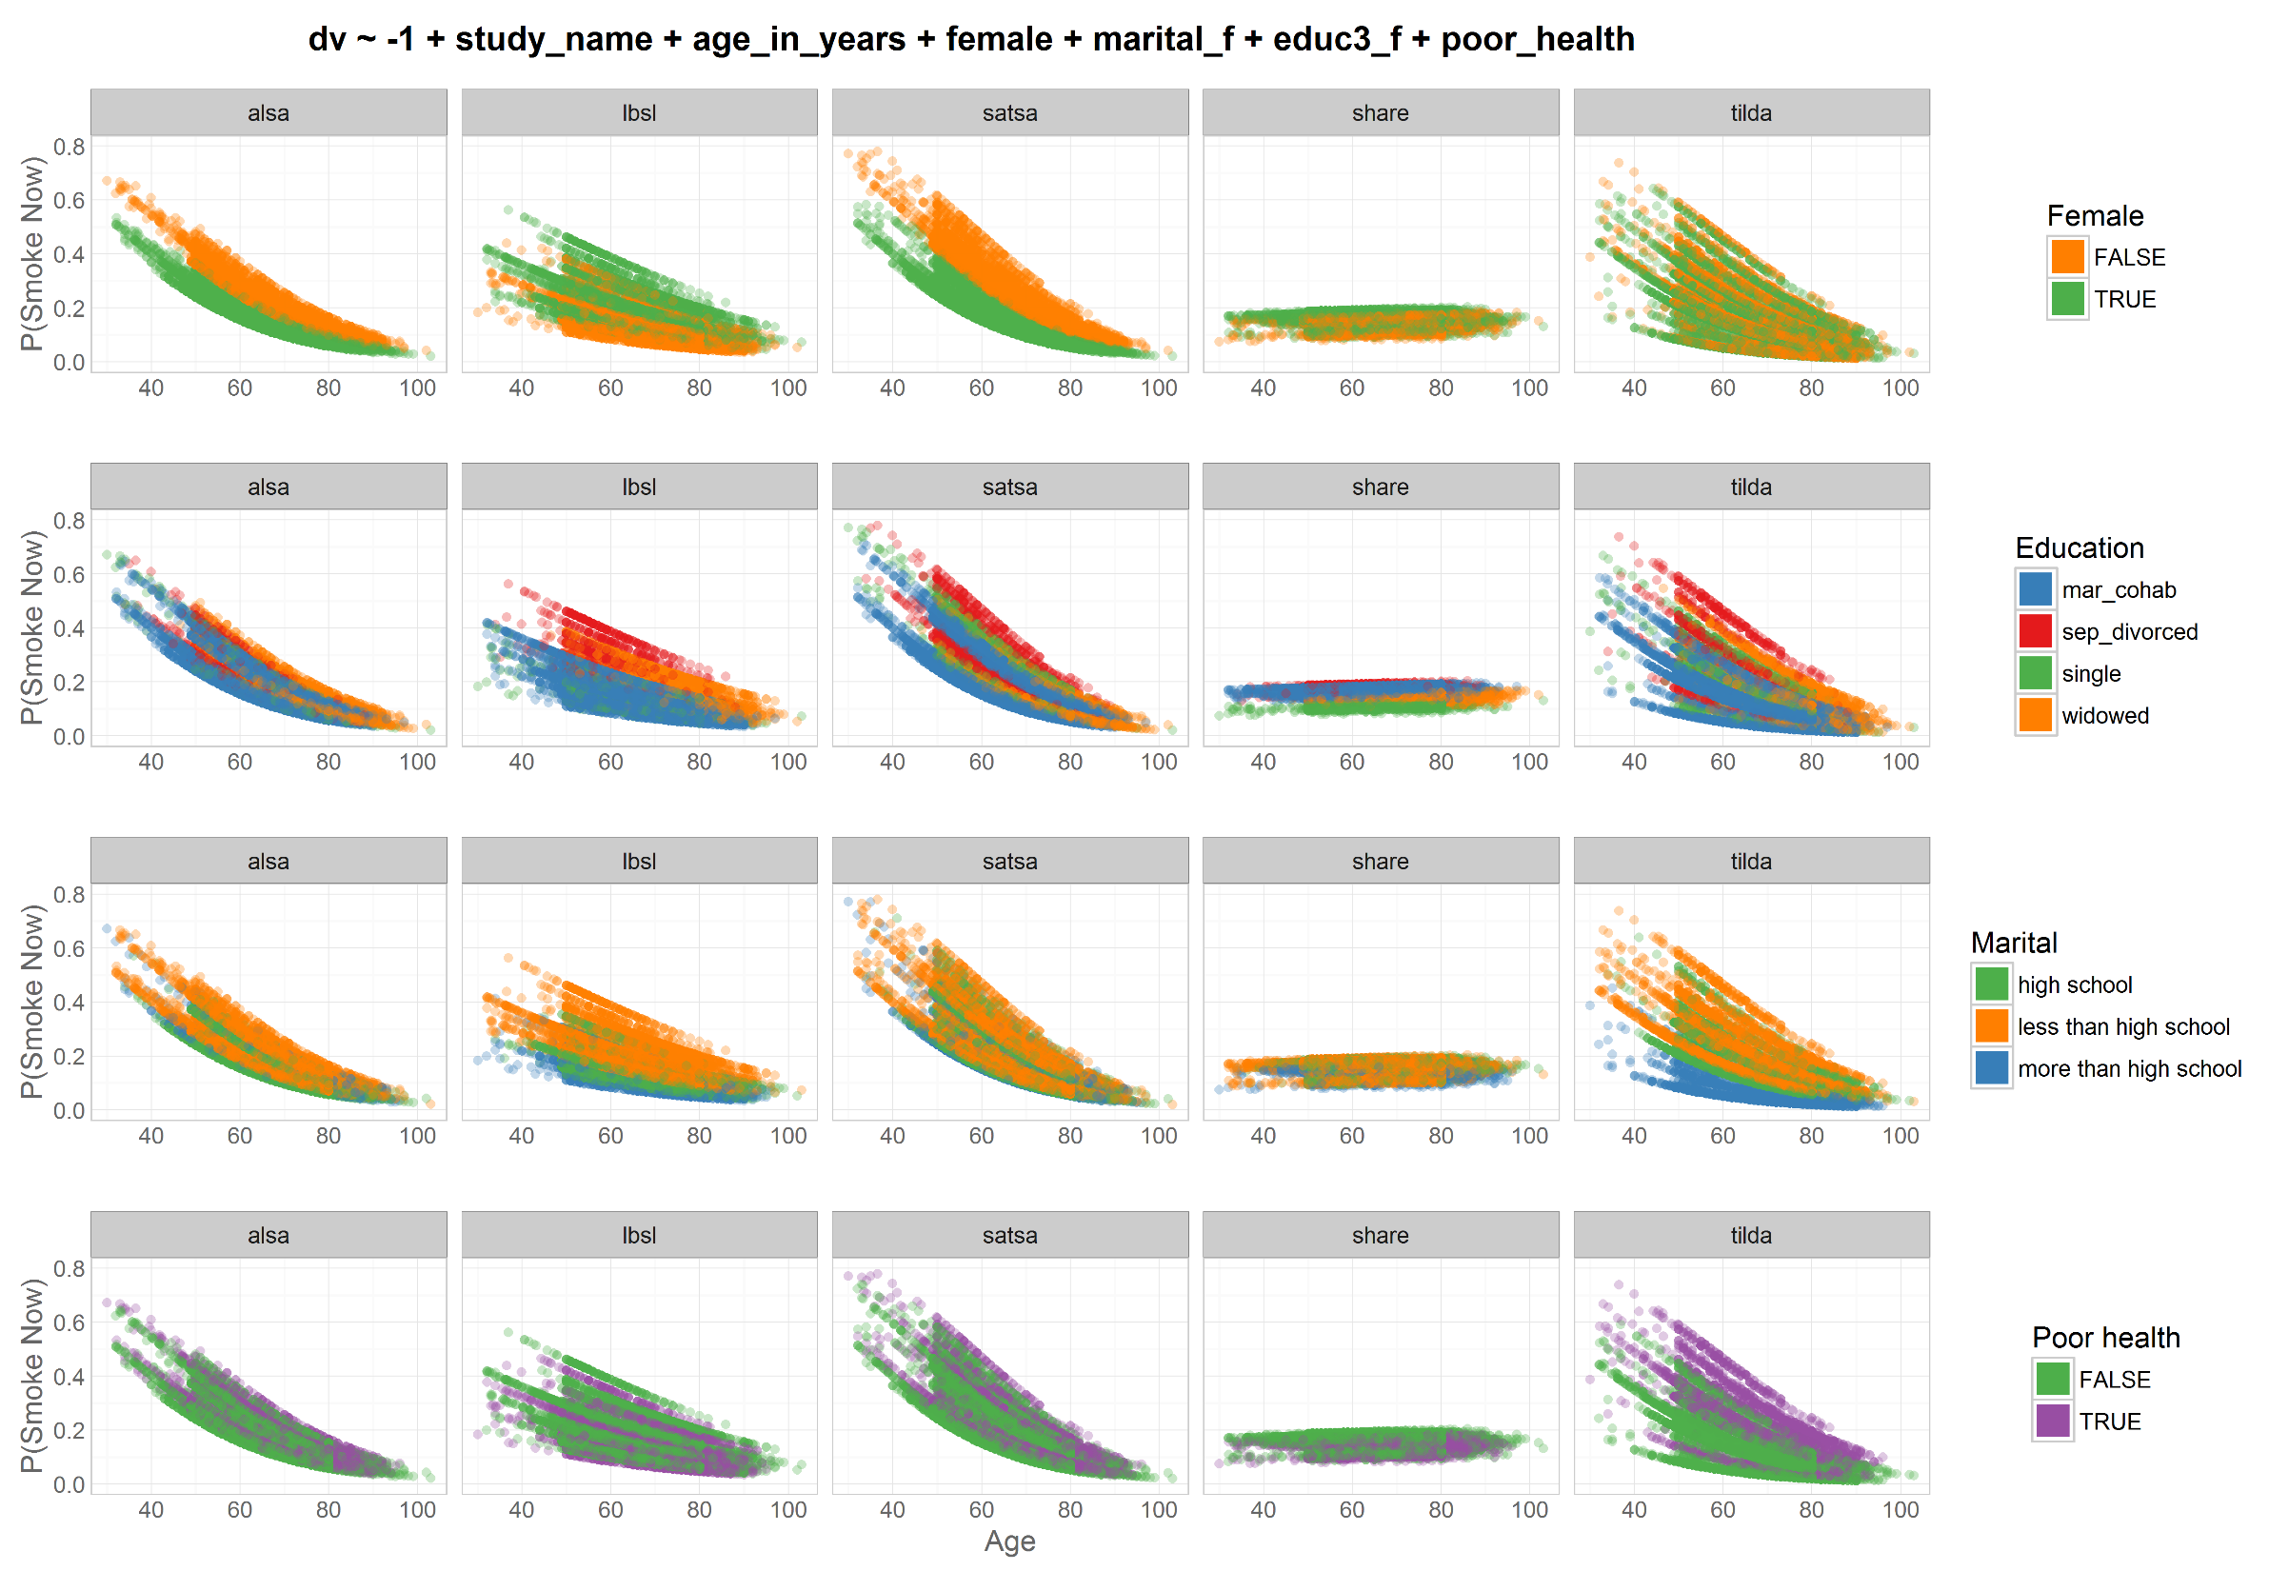
Odds|
|Prob
Study =
cluster
dto
harmony
dto

Slide 6
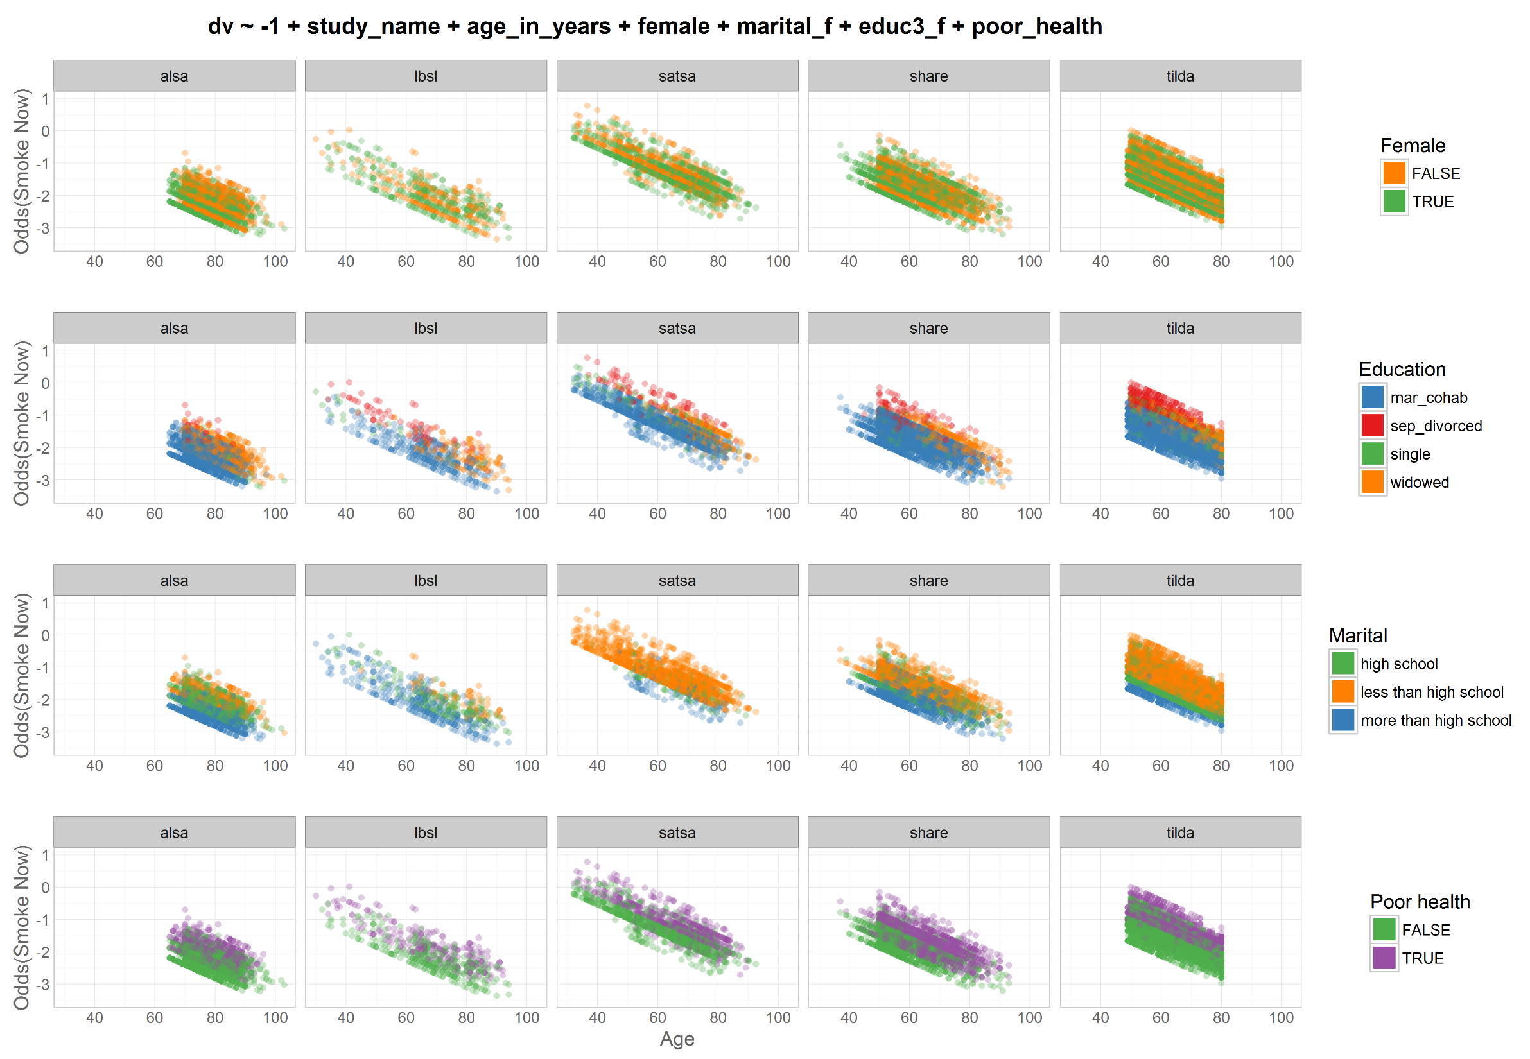
Odds|
|Prob
Study =
factor
dto
harmony
dto

Slide 7
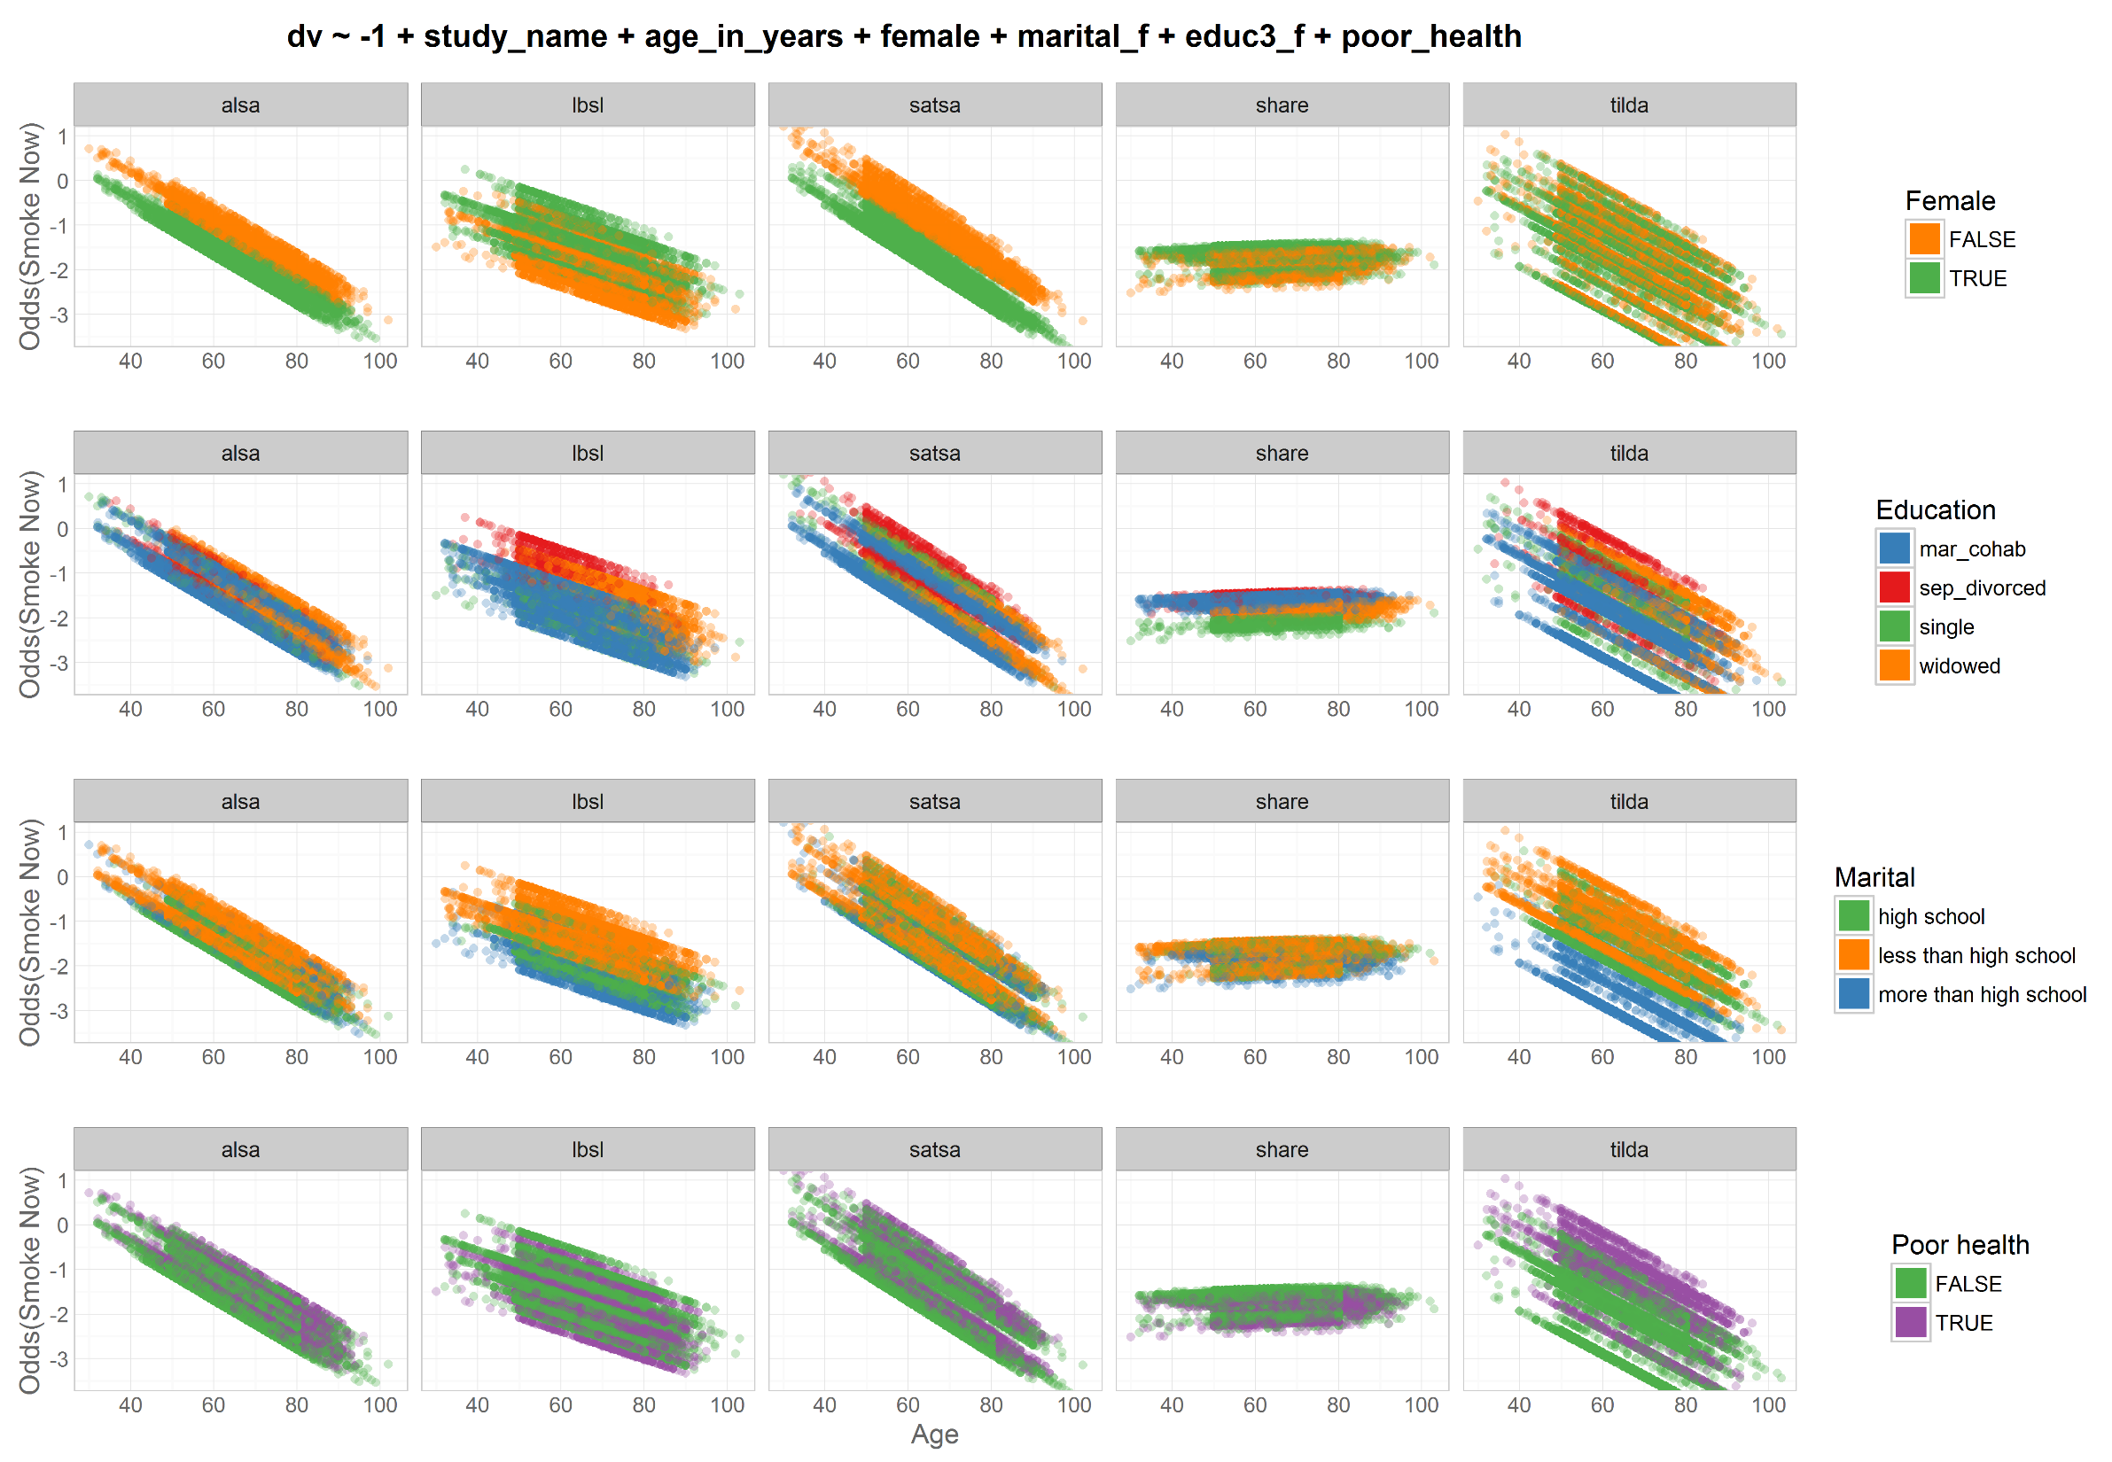
Odds|
|Prob
Study =
cluster
dto
harmony
dto

Slide 8
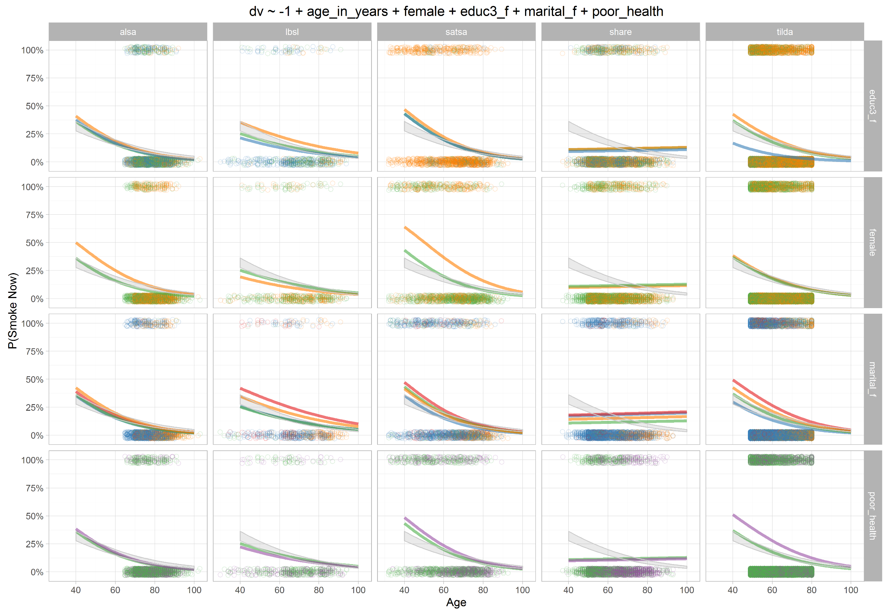
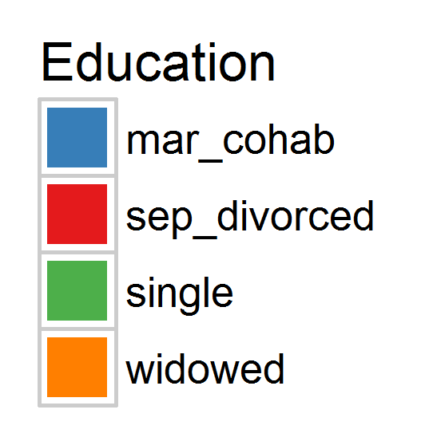
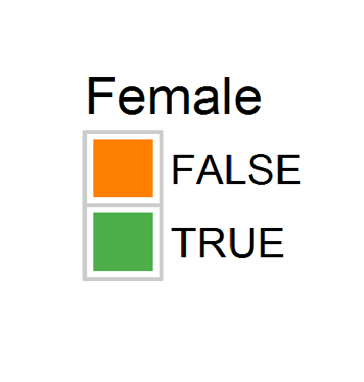
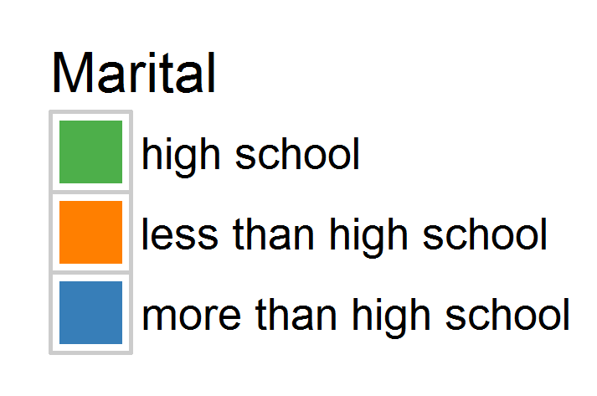
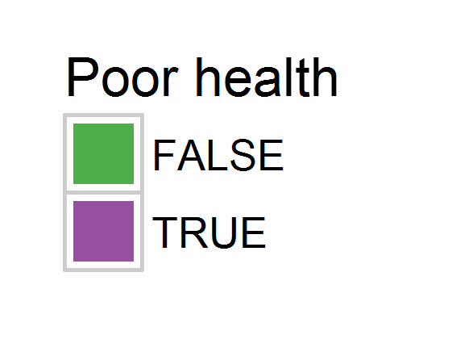
Odds|
|Prob
Study =
cluster

Slide 9
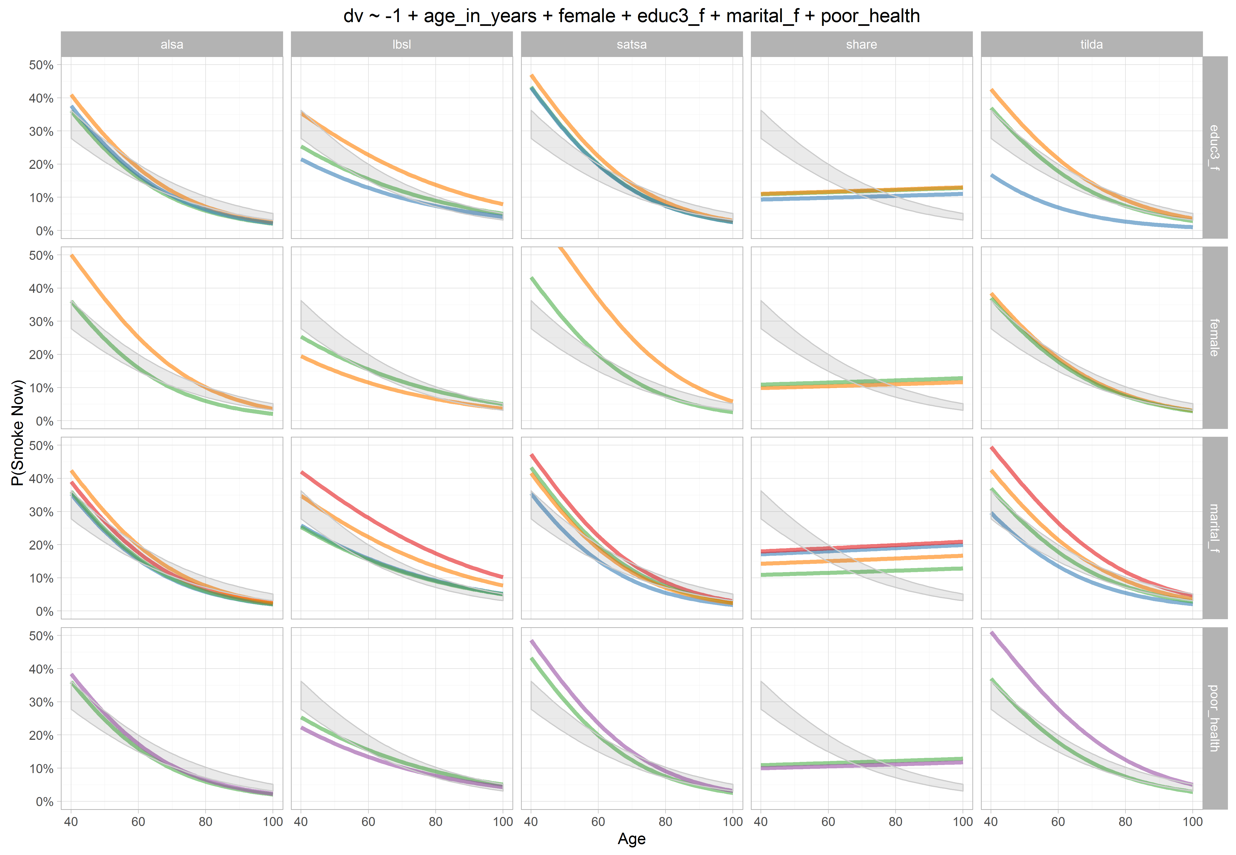
Odds|
|Prob
Study =
cluster

Slide 10
dto
graph
smoked_ever
harmony
dto
model

Slide 11
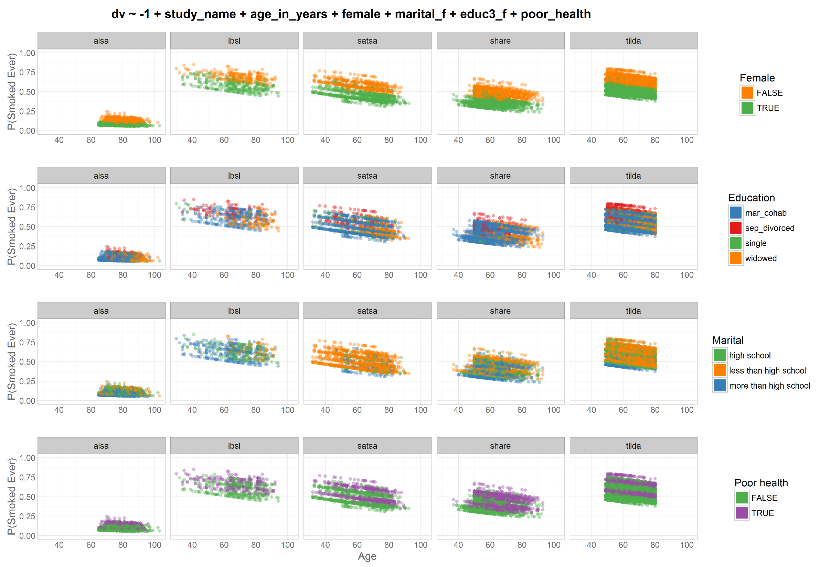
Odds|
|Prob
Study =
factor
dto
harmony
dto

Slide 12
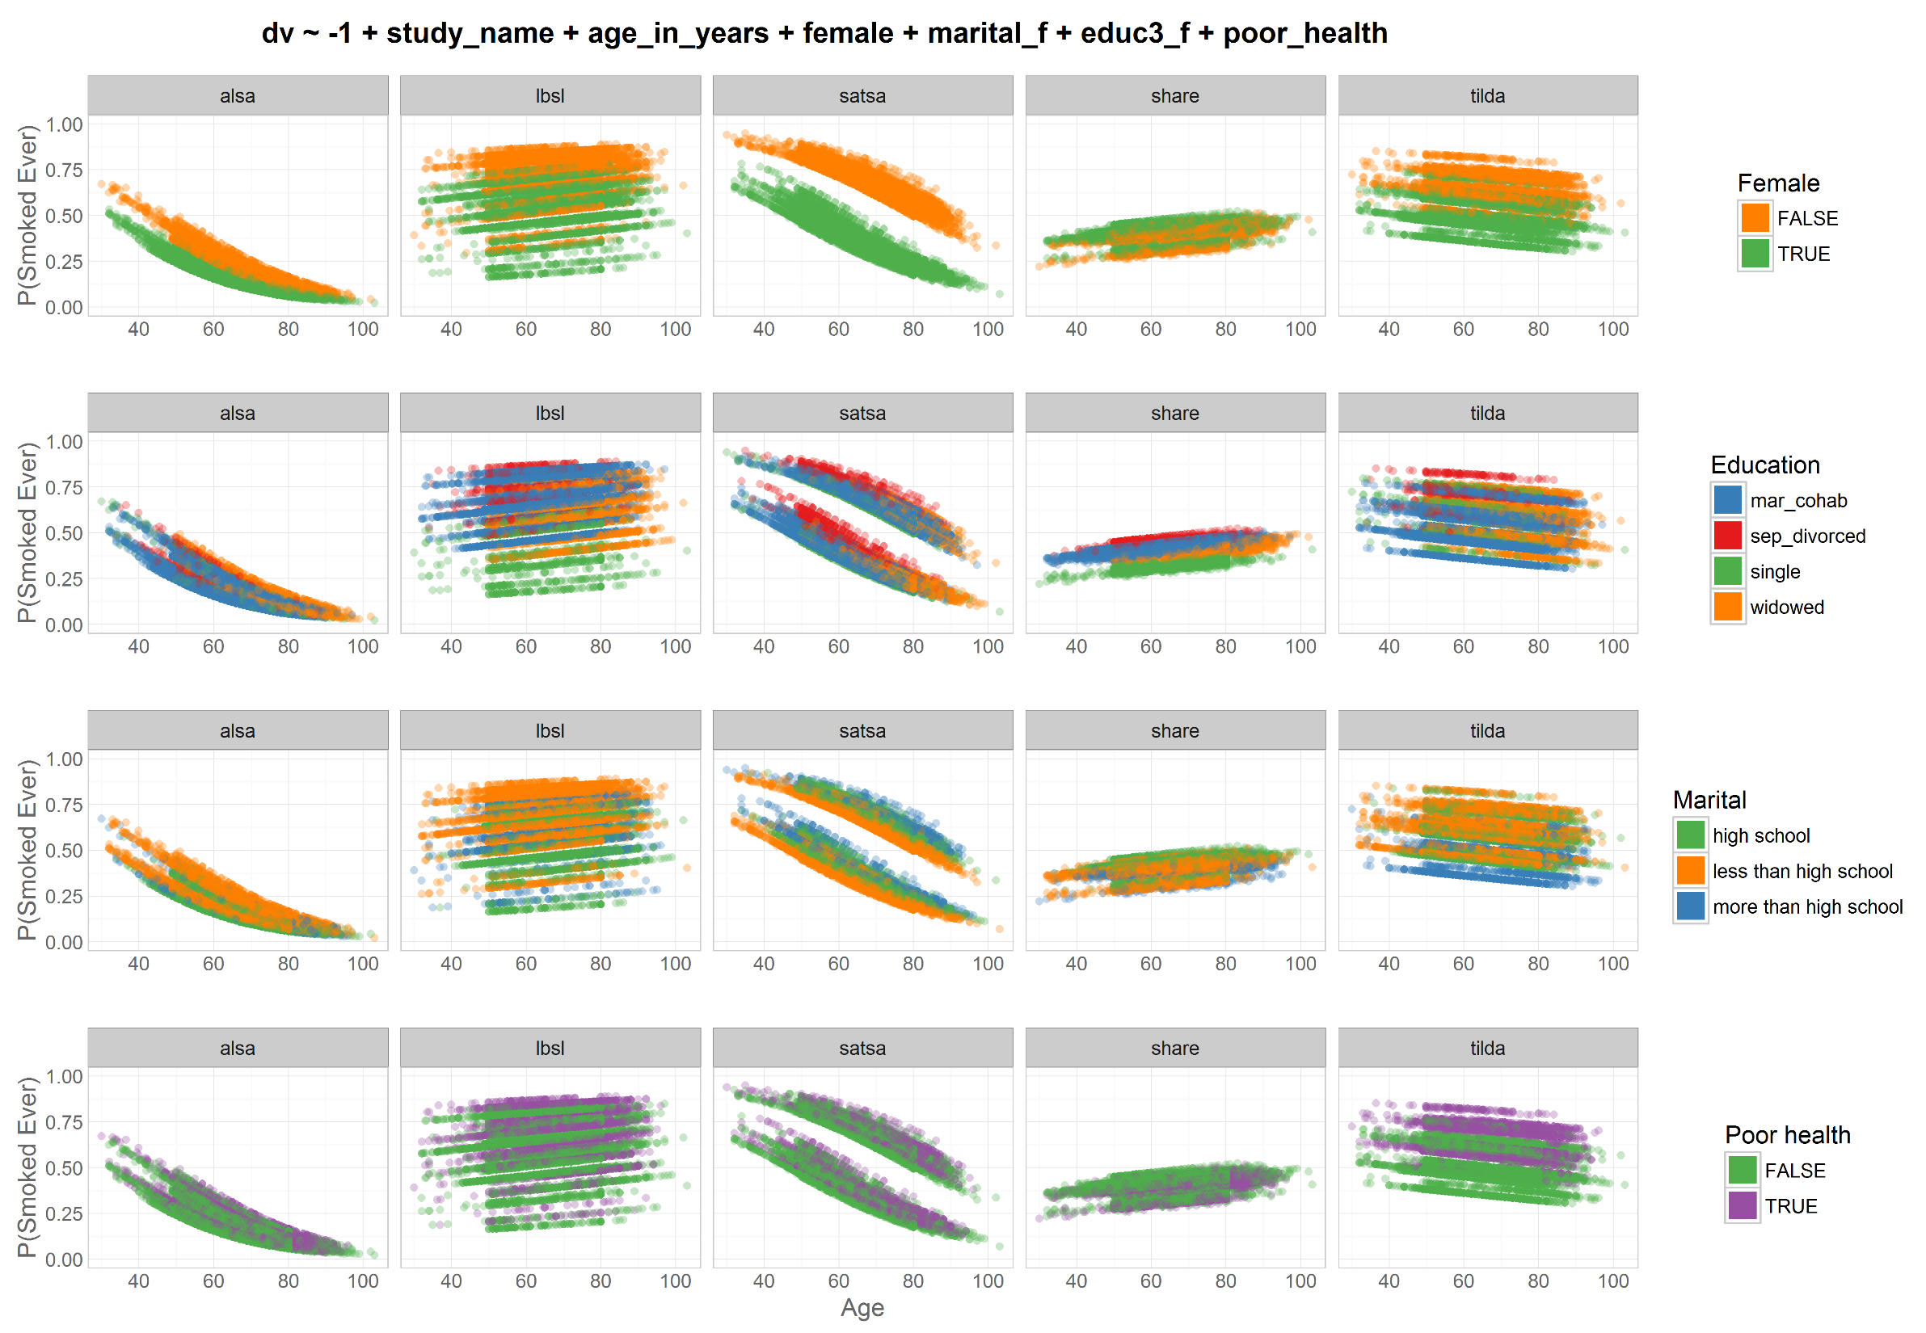
Odds|
|Prob
Study =
cluster
dto
harmony
dto

Slide 13
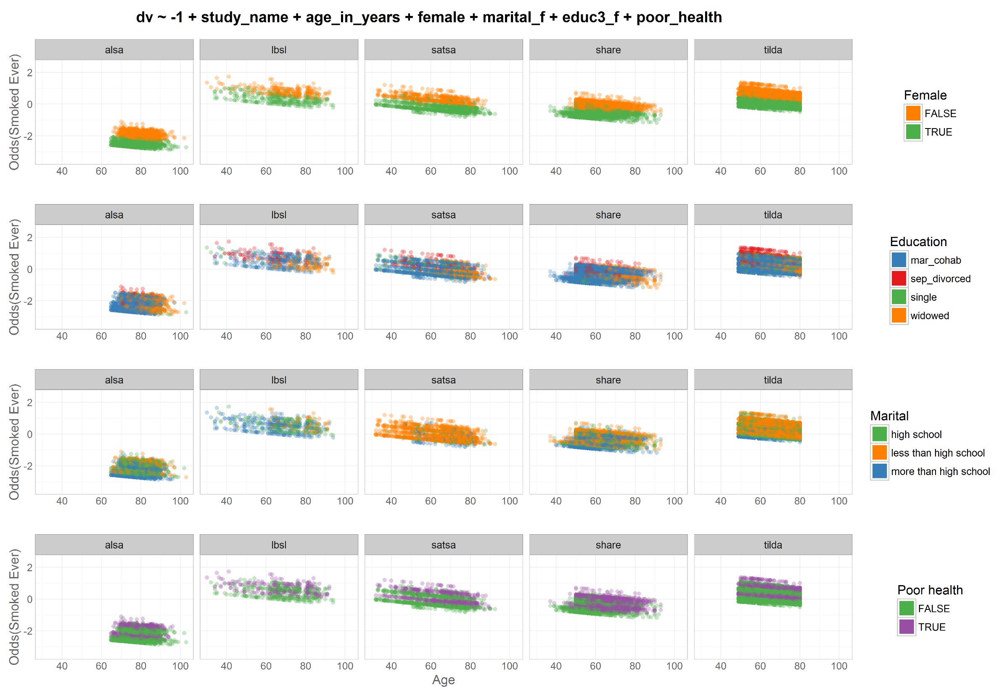
Odds|
|Prob
Study =
factor
dto
harmony
dto

Slide 14
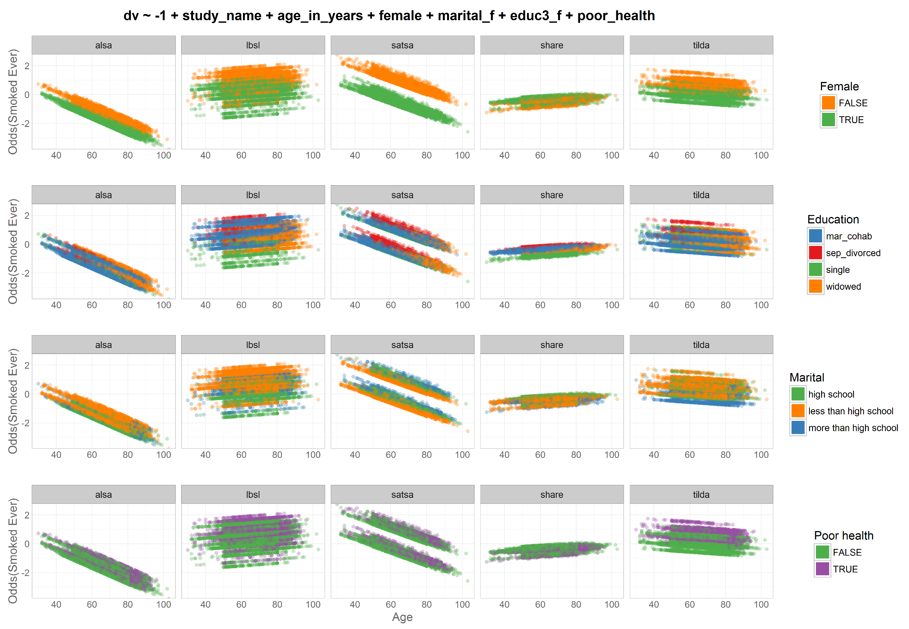
Odds|
|Prob
Study =
cluster
dto
harmony
dto

Slide 15
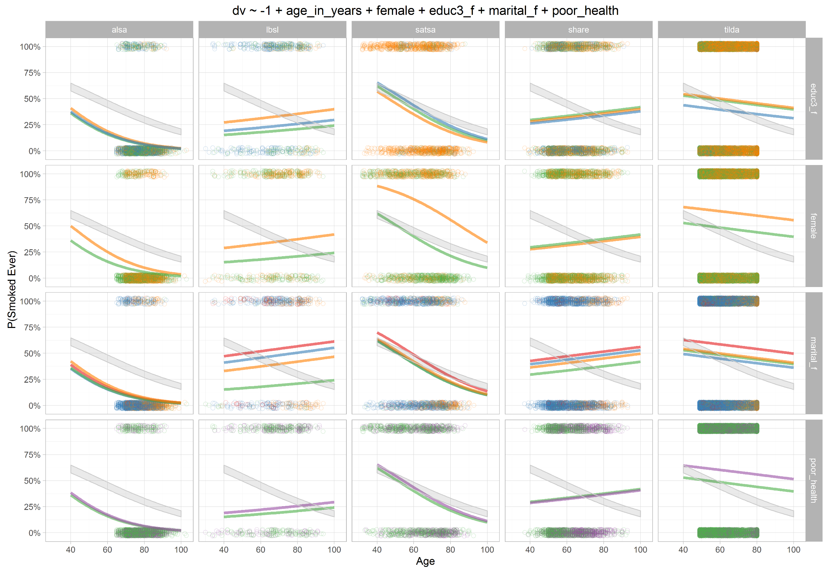
Odds|
|Prob
Study =
cluster

Slide 16
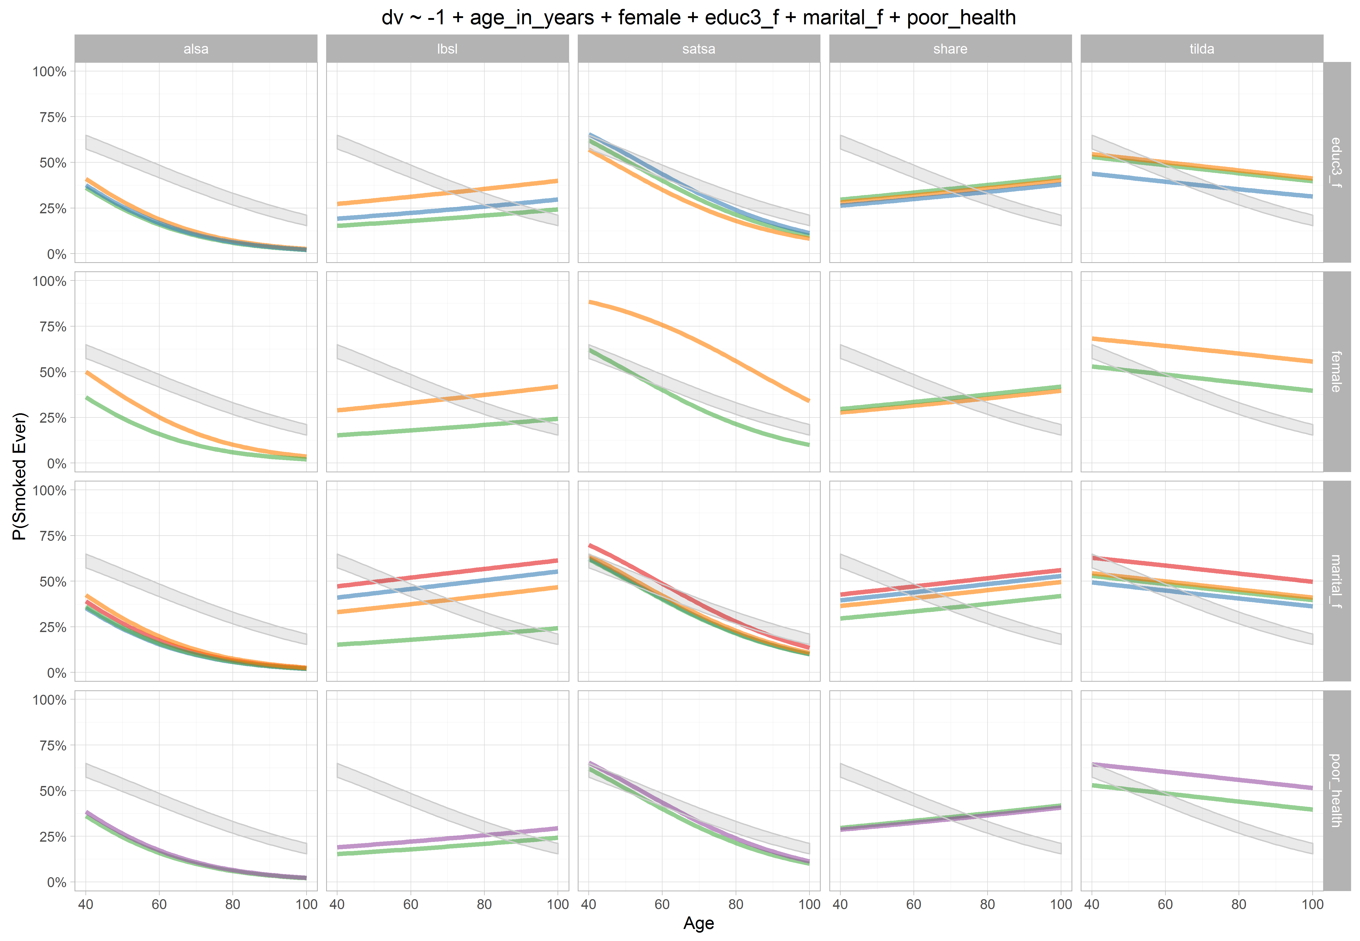
Odds|
|Prob
Study =
cluster

